Slide 1
GlyCompare
Bokan, Ben

Slide 2
Take home message
Study the motif based on glycoprofile from the synthesis network perspective.
The biosynthesis of glycan is determined by glycosyltransferases that assemble monosaccharides moieties into linear and branched glycan chains step by step . Since there is no template, the synthesis is totally stochastic process. A glycoprofile has multiple glycan and each glycan are the product of a complex network. It is very hard to simulate the synthesis of each glycan individually by using stochastic model. However, the glycoprofile provides a macroscopic description of this stochastic system. If we break down all glycan into substructures, we can study the progress of this complex network comprehensively.

Slide 3
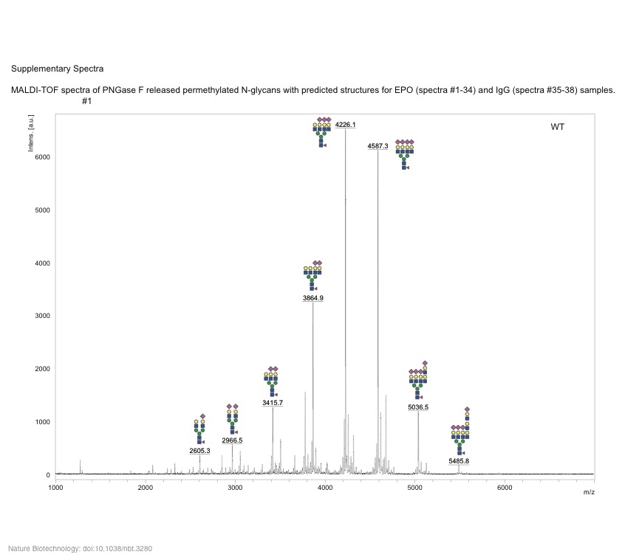
Figure 1. Workflow and idea of data preprocessing.（Need Simplify）
White box: pseudo glycoprofile
Orange box : glycan structure
Green box : glycoprofile abundance vector
Grey box : glycan abundance
This plot shows that how the glycoprofile data is transformed to glycan Substructure Vector and Glycoprofile Abundance Vector
The workflow of the analysis pipeline. The data from Glycoprofile and Glycan structure are vectored to numeric vector and then go to the hierarchical analysis.

Slide 4
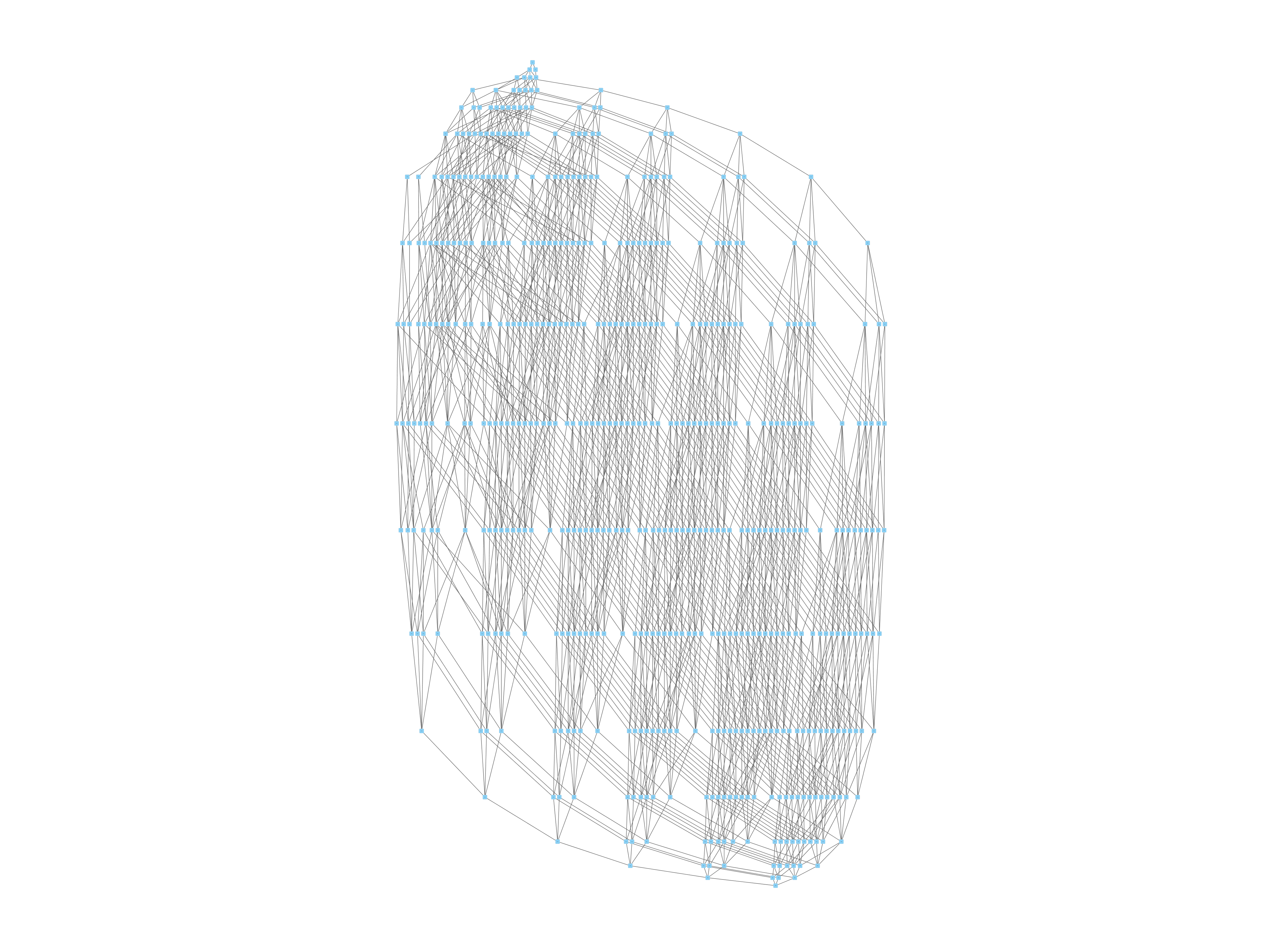
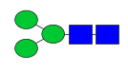
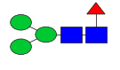
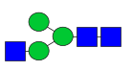
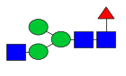
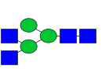
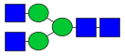
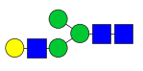
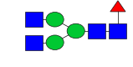
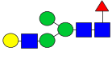
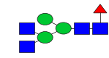
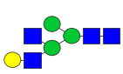
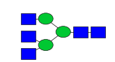
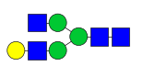
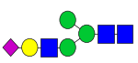
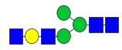
Note: a glycan can be break down to substructure and then form a synthesis network. The left side shows the top several substructures from the right side network.
…

Slide 5
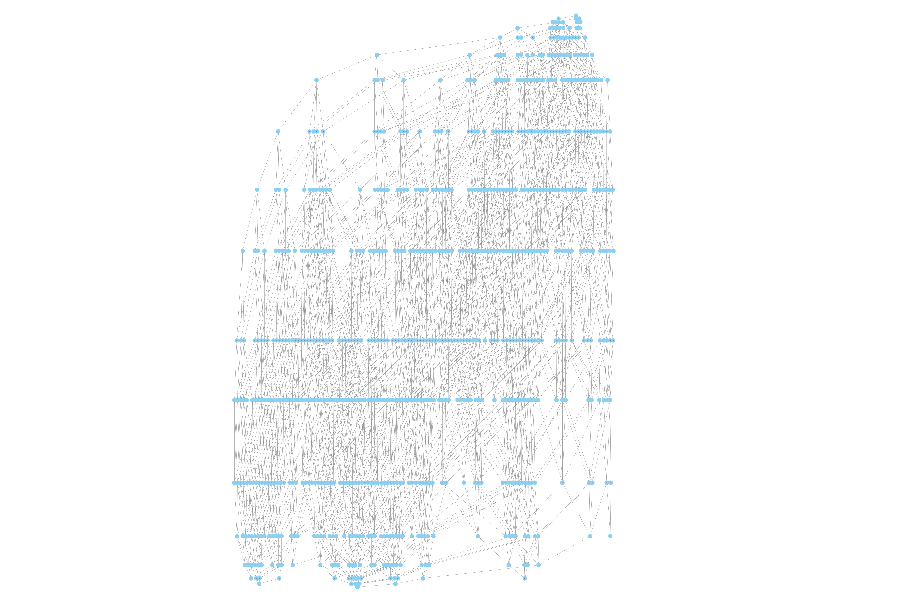
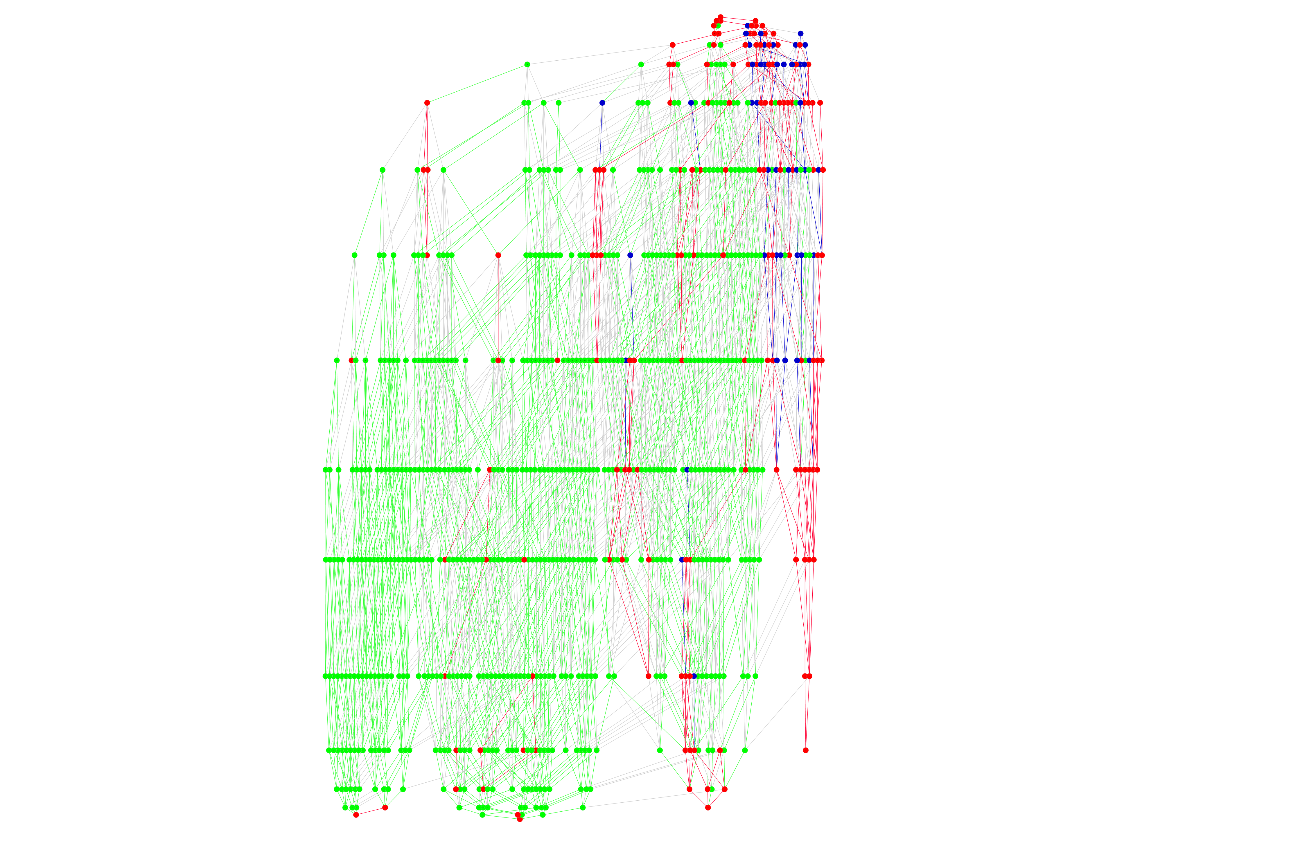
Note: multiple glycans’ synthesis network can be merged together and multiple glycoprofiles can also be merged together. Thus, the comparison across the glycoprofiles is feasible and the important change of substructure abundance can be highlighted (red and blue nodes). Only the nodes with blue and red color are picked for further network analysis.

Slide 6
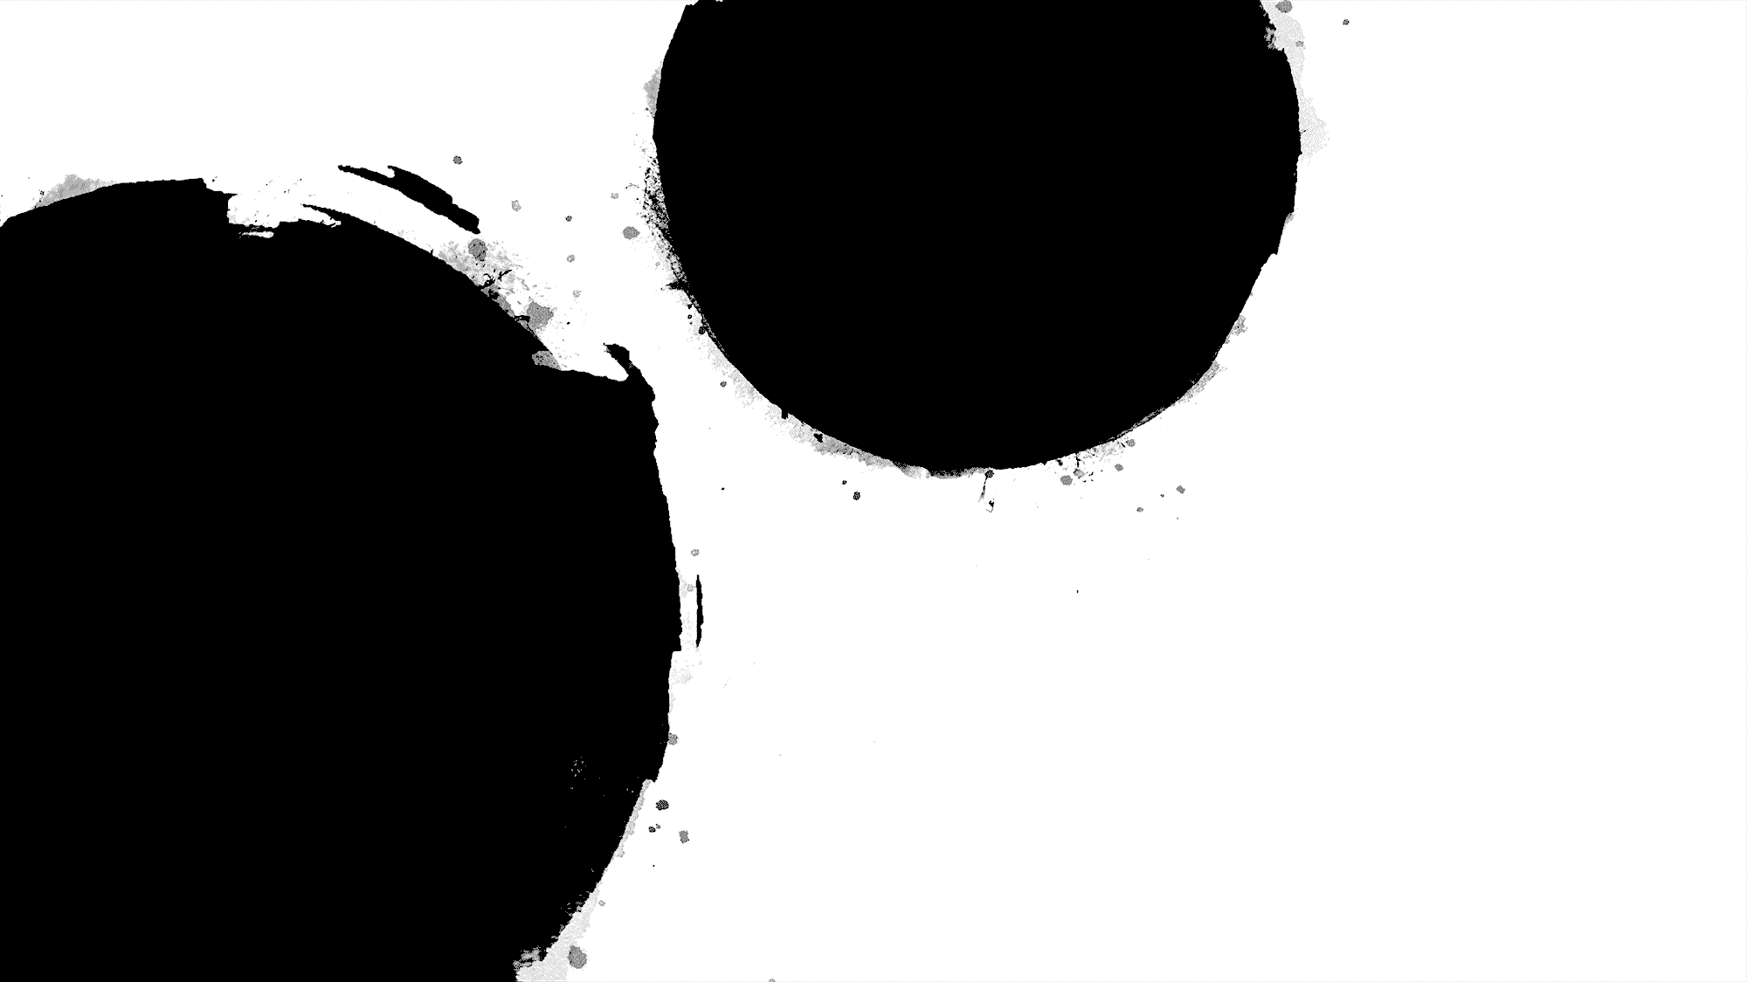
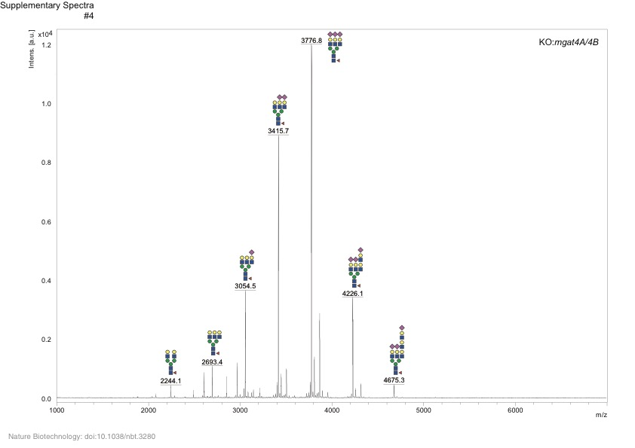
Data 1: CHO glycan data. 33 Glycoprofiles with various perturbation.

Slide 7
Data 1 part1
Note: preliminary analysis, clustering across 33 glycoprofiles, based on the abundance of the substructures and glycoprofiles.

Slide 8
Data 1 part1 Note: comparison the result between the clustering by glycan abundance, left, and clustering by substructure abundance, right. More insight information can be represented on the right plot.
G30 KO_mgat1
G25 KO_mgat2
G34 KO_fut8
G21 KO_st3gal4/6_mgat4a/4b/5
G20 KO_mgat4A/4B/5_B3gnt2
G05 KO_mgat4A/4B/5
G22 KI_st3gal6; KO_mgat4a/4b/5_st3gal4/6
G04 KO_mgat5
G03 KO_mgat4A/4B
G28 KO_mgat4B
G18 KO_st3gal4/6
G06 KO_B4GalT1
G09 KO_B4GalT4
G01 WT
G07 KO_B4GalT2
G08 KO_B4GalT3
The clustering with annotated glycan is bad because there are only a few glycans.
The glycoprofiles are clustered with substructure

Slide 9
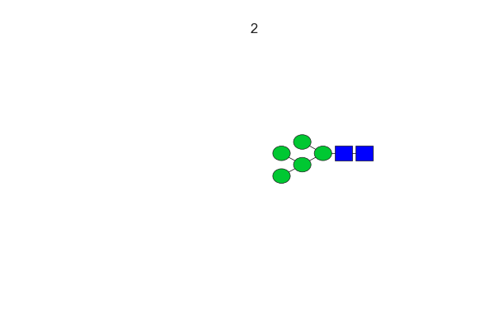
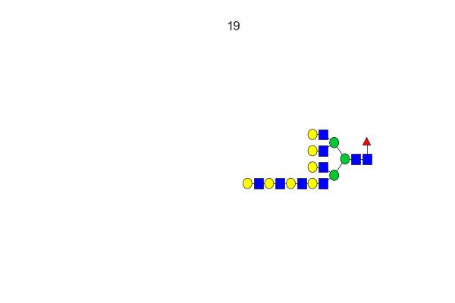
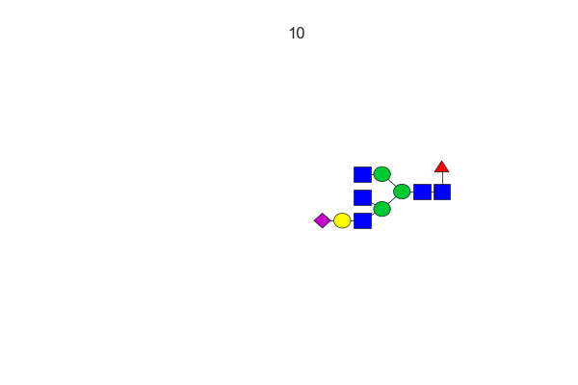
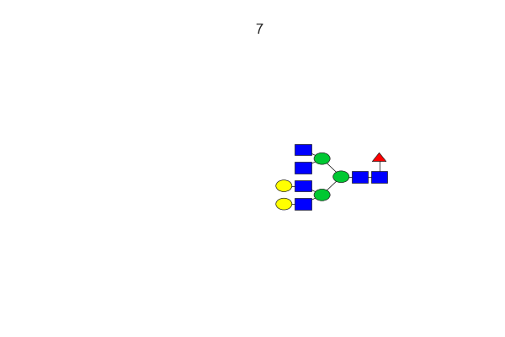
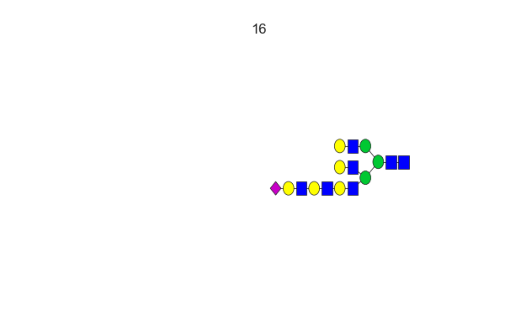
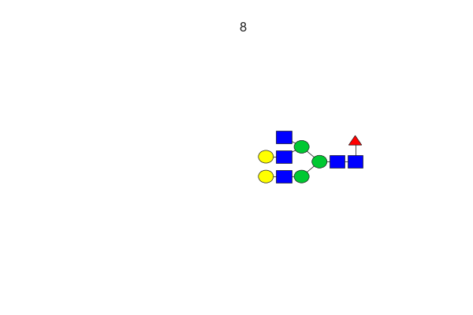
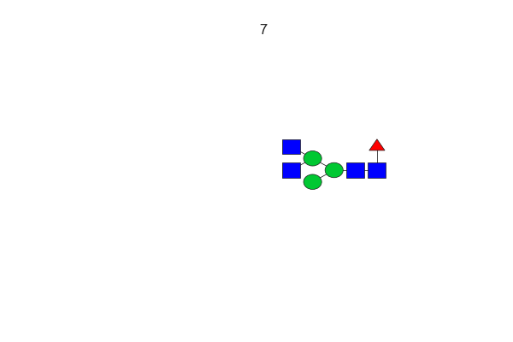
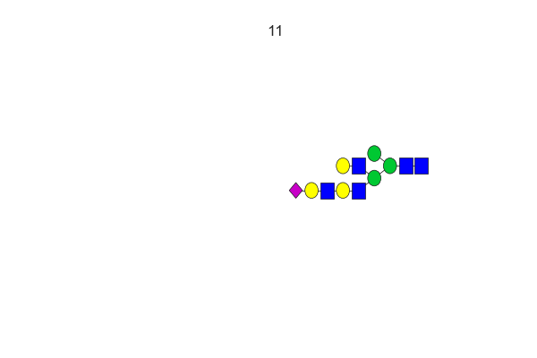
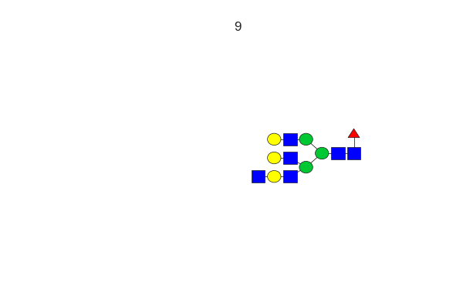
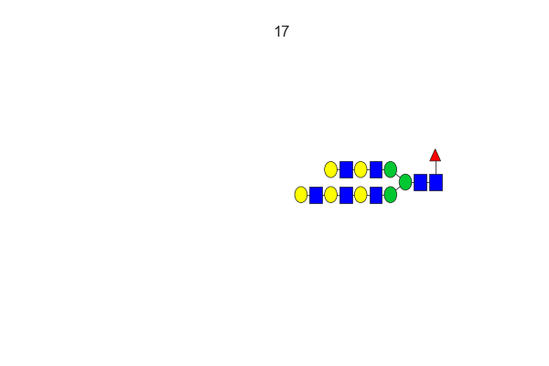
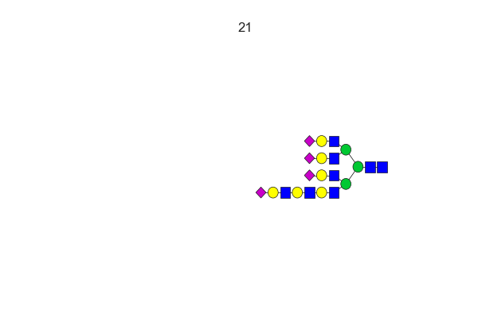
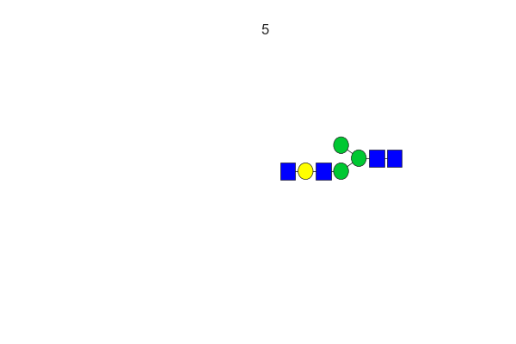
Note: the cluster of the substructure. The representative structures are generated for each cluster.

Slide 10
Data 1 part2
Note: the mean of each cluster is showed here.
G30 KO_mgat1
G25 KO_mgat2
G34 KO_fut8
G21 KO_st3gal4/6_mgat4a/4b/5
G20 KO_mgat4A/4B/5_B3gnt2
G05 KO_mgat4A/4B/5
G22 KI_st3gal6; KO_mgat4a/4b/5_st3gal4/6
G04 KO_mgat5
G03 KO_mgat4A/4B
G28 KO_mgat4B
G18 KO_st3gal4/6
G06 KO_B4GalT1
G09 KO_B4GalT4
G01 WT
G07 KO_B4GalT2
G08 KO_B4GalT3

Slide 11
Note: each column is rescaled with z_score.
G30 KO_mgat1
G25 KO_mgat2
G34 KO_fut8
G21 KO_st3gal4/6_mgat4a/4b/5
G20 KO_mgat4A/4B/5_B3gnt2
G05 KO_mgat4A/4B/5
G22 KI_st3gal6; KO_mgat4a/4b/5_st3gal4/6
G04 KO_mgat5
G03 KO_mgat4A/4B
G28 KO_mgat4B
G18 KO_st3gal4/6
G06 KO_B4GalT1
G09 KO_B4GalT4
G01 WT
G07 KO_B4GalT2
G08 KO_B4GalT3
Notes:
2-3 sentences to summarize, reorganize

Slide 12
Data 1 part2
Note: each column is rescaled with z_score. And adjusted with the WT abundance. The substructures from left to right are becoming more complicate. It shows the decreasing of the complex glycan structure when the knockout becomes more complicate. Several substructure in deep red means the significantly increase compare with other glcoprofiles and several of them have not been noticed before.
G30 KO_mgat1
G25 KO_mgat2
G34 KO_fut8
G21 KO_st3gal4/6_mgat4a/4b/5
G20 KO_mgat4A/4B/5_B3gnt2
G05 KO_mgat4A/4B/5
G22 KI_st3gal6; KO_mgat4a/4b/5_st3g4/6
G04 KO_mgat5
G03 KO_mgat4A/4B
G28 KO_mgat4B
G18 KO_st3gal4/6
G06 KO_B4GalT1
G09 KO_B4GalT4
G01 WT
G07 KO_B4GalT2
G08 KO_B4GalT3

Slide 13
Data 1 Part 3 Inferring the glycoprofile abundance vector from native mass spectrum (ongoing)
Peak
Green box : glycoprofile abundance vector
Grey box: glycan abundance
Blue box: motif structure for each signal peak
This plot shows that how the native mass spectrum data is transformed to glycan Substructure Vector and Glycoprofile Abundance Vector
The plot on the left side comes from the Nature Communication paper, which shows the native mass spectrum profile for WT, KO mgat4A, KO mgat4B profile.
The plot on the right shows it can be transferred to motif vector.
Notes:
Clustering based on the structure can be more insightful.

Slide 14
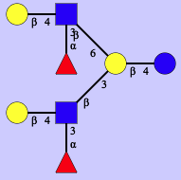
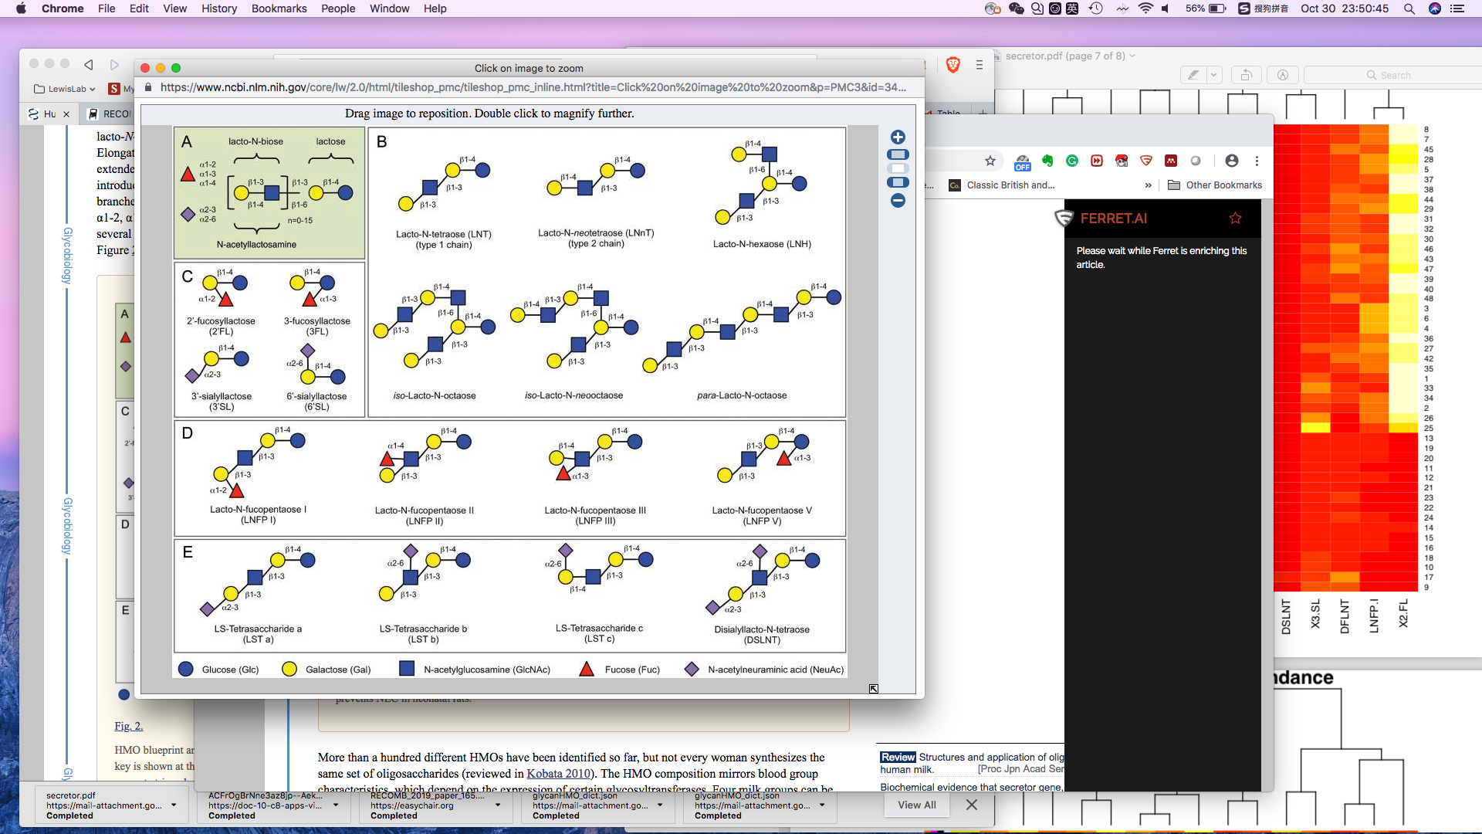
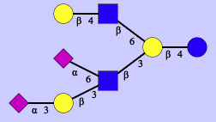
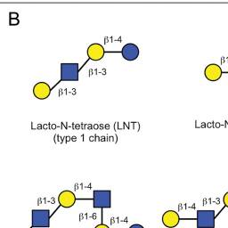
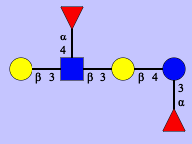
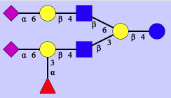
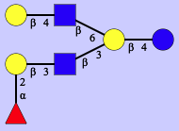
Data 2: HMO data 16 structure, 47 (48-1) glycoprofile
Notes:
DFLNH6
DFLNT2
FDSLNH

Slide 15
Data 2 part1: Information is more enriched in the motif level. Several motif clusters are highlighted in the plot.

Slide 16
Data 2 Part 2: Regression model are used to evaluate the importance of motifs as features to predict the Date after birth and Secretor(or not) phenotypes. Motifs that are enriched with DPP, Secretor phenotype. Sialyation is more abundant in the early date after the birth. And x80 motif which is Lst b, have different abundance between the secretor and non secretor. Y axis is –log(p), x axis is the coefficient value.
Notes:
Biological meaning; secretor non-secretor; use them as marker? Predict the abundance?

Slide 17
Data 2 Part 2: The abundance of Lst b, which can be a precursor for others, are recalculated as a substructure in synthesis network, which might give us more biological information.

